Slide 1

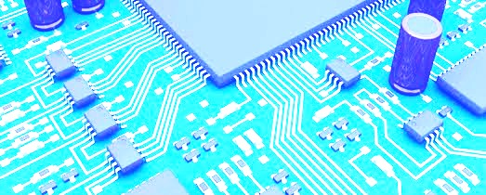
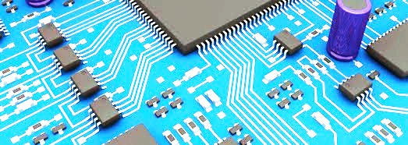
Performance driven optimizations in fpga based qam systems
Master Thesis ITIV, Embedded Systems Group
Karlsruhe Institute of Technologies
Pandora 2015 presentation
Alberto Sonnino
(1794121)

Slide 2
Introduction & Motivation
Context:
High SNR (Signal to Noise Ration) and high data rate requires advanced techniques.
Contribution to reach terabit’s communication in future application.
Hardware Choice:
The great configurability, flexibility and low cost make FPGAs an adequate hardware support for this project.
Currently clocked below 1GHz: need improvement on all abstraction layers.
Implementation based on Xilinx Virtex 7 FPGA kit.
Modulation Choice:
Requirement of advanced modulation able to carry many bits of information per symbol. Quadrature Amplitude Modulation (QAM) is widely used in digital communications.
Higher order QAM implies higher data rate but may cause symbol’s misinterpretation at the receiver, therefore, 16-QAM is chosen.

Slide 3
Filter Choice:
Needed to avoid ISI (Inter Symbols Interferences) and noise by limiting the transmission band.
FIR (Finite Impulse Response) filters have linear phase, same error per cycle (no feedback) and inherent stability. Squared Root Raised Cosine (SRRC) filter is selected.
No filter parameter’s optimization but efficient implementation.
On this paper:
Performance optimization of QAM transmitter, exploiting the degree of parallelism of the FPGA platform and mixed-domains (time and frequency) where beneficial.
Start with a general view of the transmitter and then goes deeper and deeper in the abstraction layers.

Slide 4
Fundamentals
QAM mapping:
QAM is efficiently represented by a constellation diagram, standard rectangular constellation is preferred in this work for his poor overhead and simplicity.
Multiples QAM order format are possible (16-QAM, 32-QAM, 64-QAM, etc.), denoted by M-QAM.
M denotes the number of points in the constellation, each symbol contains log₂(M) bits.
Higher order QAM format implies higher data rate but may causes symbol’s misinterpretation at the receiver, therefore, 16-QAM is chosen.
Gray Code associates a symbol to a given constellation position ensuring one bit difference between adjacent symbols.
16-QAM clusters the input by groups of 4 bits and apply:

Slide 5
Fourier Transform:
Fourier Transform decomposes the signal in an alternative representation made of sinus and cosinus.
For discrete inputs, the Discrete Fourier Transform (DFT) sends a signal from the time to the frequency domain and, the Inverse Discrete Fourier Transform (IDFT) takes it back:
Linear operations in time domain have an equivalent in frequency domain: convolution in time domain becomes a simple multiplication in frequency domain.
Fast Fourier Transform (FFT) is an efficient
algorithm to compute DFT. Computational
complexity of DFT is O(N²) while FFT has a
complexity of O(Nlog₂(N)).
The inverse transform can be computed using the Inverse Fast Fourier Transform (IFFT).

Slide 6
Filter:
Limit the transmitted signal into a defined part of the channel to
prevent interferences with adjacent channels: a filter respecting
Nyquist criteria avoids ISI.
FIR filters posses a linear phase, a same error every cycle
(no feedback) and inherent stability.
Matched filters optimize the SNR (if only stochastic noise) by convolving the input with an expected template of this input.
A filter having all those properties is the SRRC filter and constitute a good compromise between spectral efficiency and low ISI.
Time Domain
Frequency Domain
Convolution: difficultly parallelizable
Multiplication: easily parallelizable
H₀
H₁
H_{N}
X₀
_{X}
Y_{N}
X₁
_{X}
Y_{N}
X_{N}
_{X}
Y_{N}

Slide 7
Modulator:
Local Oscillator (LO) generate the carrier sinusoidal waves at a fixed frequency f₀. I component is multiplied by cos and Q component by sin (or cos shifted by 90°).
Then, we subtract those two products and the transmitter outputs the result.
Summary:
Re
Re
Modulator
X
cos
out
cos
+
x
LO
+
out
+
-
Im
+
90°
sin
X
x
-
Im
sin

Slide 8
Concepts & Methodology
Strategy:
Build a single channel (without parrallelization) mixed-domain modulator.
Compare the output of each block with a MATLAB simulation (considered as perfect).
Optimize this single channel tranmitter to reach high frequencies and low area usage.
Parrallelize the transmitter.
Simple transmitter:

Slide 9
Summary & Further Improvements
Topic:
Performance optimization of QAM transmitter, exploiting the degree of parallelism of the FPGA platform and mixed domains (time and frequency) where beneficial.
Some Results:
Further Improvements:
Try implementation with DSP48E1 logic core.
Optimize parallelization.
Clock | 62.5 MHz
Parallel inputs | 16
DSP | 57%
LUTs | 49%
Effective speed | 16 * 62.5 = 1GHz

Slide 10
Thanks for your attention !

